Slide 1
Table of Contents
This slide deck consists of slides used in 2 lecture videos in Week 3. Below is a list of shortcut hyperlinks for you to jump into specific sections.
(page 2) Week 3: Using Django Forms Capabilities
(page 16) Week 3: Data Validation with Django Forms
Notes:
Note from Chuck. If you are using these materials, you can remove my name and URL from this replace it with your own, but please retain the CC-BY logo on the first page as well as retain the entire last page when you remix and republish these slides.
TO Highlight – go to https://tohtml.com/html/ - paste and then do a "Paste RTF"

Slide 2

Forms in Django
Charles Severance
www.dj4e.com
https://samples.dj4e.com/form/
https://docs.djangoproject.com/en/3.0/topics/forms/
https://github.com/csev/dj4e-samples/tree/master/form

Slide 3

Forms in Django
Browser
Linux
D
O
M
N
G
I
N X
WGSIConfig
settings.py
Django
Routing
Click
urls.py
views.py
Parse
Response
Views
Templates
forms.py
Javascript
Database
Shell
Models
models.py
/admin
admin.py

Slide 4
Django's role in forms (DRY)
Handling forms is a complex business. Consider Django’s admin, where numerous items of data of several different types may need to be prepared for display in a form, rendered as HTML, edited using a convenient interface, returned to the server, validated and cleaned up, and then saved or passed on for further processing. Django’s form functionality can simplify and automate vast portions of this work, and can also do it more securely than most programmers would be able to do in code they wrote themselves.
Django handles three distinct parts of the work involved in forms:
preparing and restructuring data to make it ready for rendering
creating HTML forms for the data
receiving and processing submitted forms and data from the client
It is possible to write code that does all of this manually, but Django can take care of it all for you.
https://docs.djangoproject.com/en/3.0/topics/forms/#django-s-role-in-forms

Slide 5
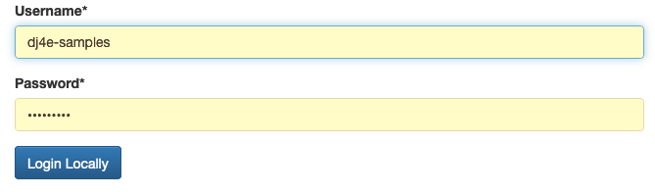
It takes a lot of CSS to make forms pretty
https://samples.dj4e.com/accounts/login/

Slide 6
Form Handling Flow is Actually Complex
Create
Produce empty form, check post data for validity, re-display form with errors if necessary, add the data to the database, and redirect the user to a success page with a success message
Update
Load old data, form with old data, check post data for validity, re-display form with errors if necessary, update the data to the database, and redirect the user to a success page with a success message
Delete
Load old data, produce confirmation page with a POST form, receive the post data, delete the record, and redirect the user to a success page with a success message

Slide 7
Create Form Flow
GET Request
Cancel
Empty Form
Enter Data
model
POST with data
Fix Data
Validate Data
Form with old data
Error?
Cancel
Store Data
Redirect to success URL
Message
GET success URL
Make Page
Success page Yay!

Slide 8
Edit Form Flow
GET Request
Load Data
Cancel
Error 404 Page
Error?
Form with old data
Edit Data
model
POST with data
Fix Data
Validate Data
Form with old data
Error?
Cancel
Load Data
Error 404 Page
Error?
Store Data
Redirect to success URL
Message
GET success URL
Make Page
Success page Yay!

Slide 9
Delete Form Flow
GET Request
Load Data
Cancel
Error 404 Page
Error?
Confirmation Form
Yes
model
POST with key
Load Data
Error 404 Page
Error?
Delete
Redirect to success URL
Message
GET success URL
Make Page
Success page Yay!

Slide 10
Django forms act as "glue"
Generate the necessary HTML to send to the browser
Allow for consistent look and feel across all the forms in an application
Receive the POST data coming back from the browser
Validate the incoming POST data and produce HTML for an error screen if necessary
Move the data from the form into a model and then store it in the database automatically
https://docs.djangoproject.com/en/3.0/topics/forms/#django-s-role-in-forms

Slide 11
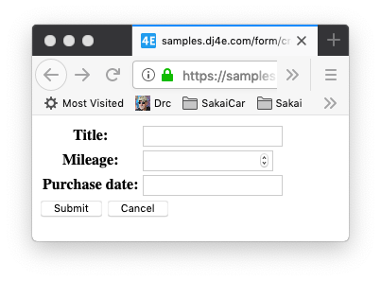
A simple form
dj4e-samples/form/forms.py
from django import forms
from django.core.exceptions import ValidationError
from django.core import validators
class BasicForm(forms.Form):
title = forms.CharField(validators=[
validators.MinLengthValidator(2, "Please enter 2 or more characters")])
mileage = forms.IntegerField()
purchase_date = forms.DateField()
https://samples.dj4e.com/form/create

Slide 12
Dumping a form object
https://samples.dj4e.com/form/example
dj4e-samples/form/forms.py
<tr><th>
<label for="id_title">Title:</label></th>
<td><input type="text" name="title"
required id="id_title"></td></tr>
<tr><th>
<label for="id_mileage">Mileage:</label>
</th><td>
<input type="number" name="mileage" required id="id_mileage">
</td></tr>
<tr><th>
<label for="id_purchase_date">
Purchase date:</label>
</th><td>
<input type="text" name="purchase_date"
required id="id_purchase_date">
</td></tr>
class BasicForm(forms.Form):
title = forms.CharField(validators=[
validators.MinLengthValidator(2, "...")])
mileage = forms.IntegerField()
purchase_date = forms.DateField()
dj4e-samples/form/views.py
from form.forms import BasicForm
def example(request) :
form = BasicForm()
return HttpResponse(form.as_table())
Notes:
return HttpResponse(form.as_table()) helps to generate html as shown on the right

Slide 13
A form in a template
dj4e-samples/form/templates/form/form.html
<p>
<form action="" method="post">
{% csrf_token %}
<table>
{{ form.as_table }}
</table>
<input type="submit" value="Submit">
<input type="submit"
onclick="window.location='{% url 'form:main' %}' ; return false;"
value="Cancel">
</form>
</p>

Slide 14
A form in a template
https://samples.dj4e.com/form/create
dj4e-samples/form/views.py
class SimpleCreate(DumpPostView):
def get(self, request) :
form = BasicForm()
ctx = {'form' : form}
return render(request, 'form/form.html', ctx)

Slide 15
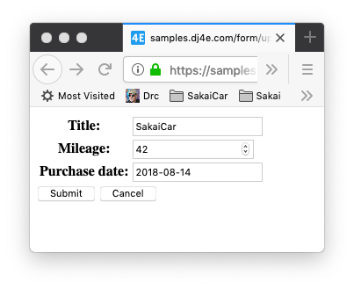
Pulling existing data into a form
https://samples.dj4e.com/form/update
dj4e-samples/form/views.py
class SimpleUpdate(DumpPostView):
def get(self, request) :
old_data = {
'title': 'SakaiCar',
'mileage' : 42,
'purchase_date': '2018-08-14'
}
form = BasicForm(old_data)
ctx = {'form' : form}
return render(request, 'form/form.html', ctx)

Slide 16
Data Validation in FORMS

Slide 17
Create Form Flow
GET Request
Cancel
Empty Form
Enter Data
model
POST with data
Fix Data
Validate Data
Form with old data
Error?
Cancel
Store Data
Redirect to success URL
Message
GET success URL
Make Page
Success page Yay!

Slide 18
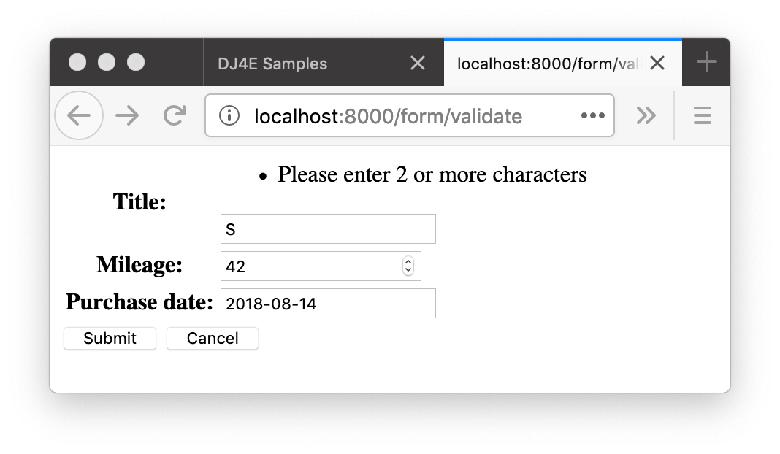
Form Data Errors
https://samples.dj4e.com/form/validate
Sometimes there are validation rules when you are filling out a form.
When you submit the form, the view code checks the data to see if there are errors
If there are errors, data is not saved and the user is notified and usually given a chance to edit and resubmit

Slide 19
Django form validation
dj4e-samples/form/forms.py
class BasicForm(forms.Form):
title = forms.CharField(validators=[
validators.MinLengthValidator(2, "Please enter 2 or more characters")
])
mileage = forms.IntegerField()
purchase_date = forms.DateField()
https://docs.djangoproject.com/en/3.0/ref/validators/

Slide 20
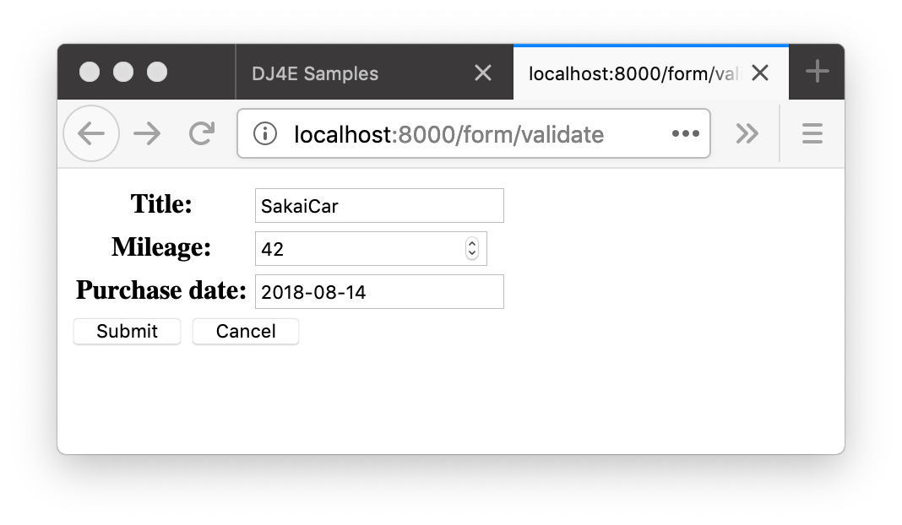
Validation
GET
class Validate(View):
def get(self, request) :
old_data = {
'title': 'SakaiCar',
'mileage' : 42,
'purchase_date': '2018-08-14'
}
form = BasicForm(initial=old_data)
ctx = {'form' : form}
return render(request, 'form/form.html', ctx)
def post(self, request) :
form = BasicForm(request.POST)
if not form.is_valid() :
ctx = {'form' : form}
return render(request, 'form/form.html', ctx)
# Save the Data
return redirect('/form/success')
def success(request) :
return HttpResponse('Thank you!')
200
dj4e-samples/form/views.py

Slide 21
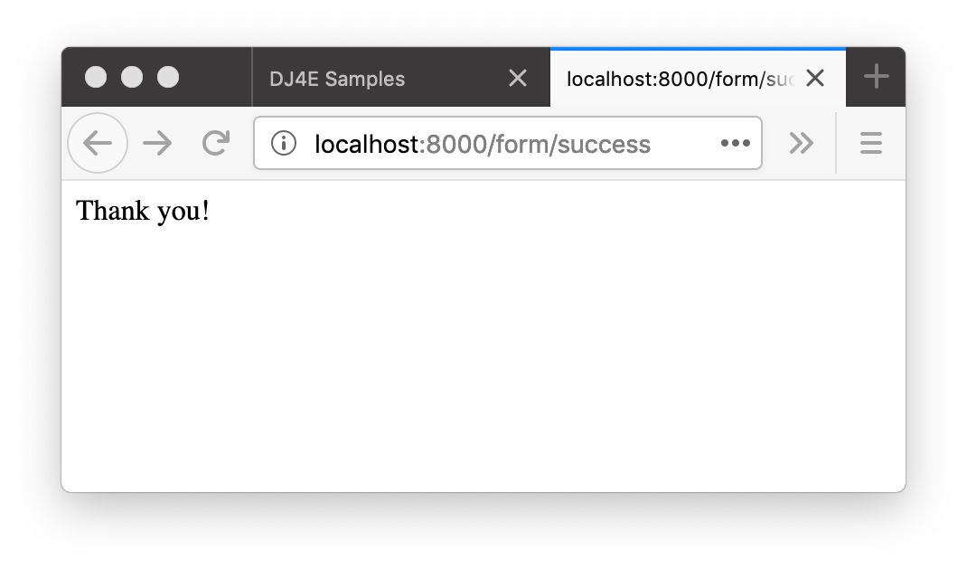
Validation
https://samples.dj4e.com/form/validate
class Validate(DumpPostView):
def get(self, request) :
old_data = {
'title': 'SakaiCar',
'mileage' : 42,
'purchase_date': '2018-08-14'
}
form = BasicForm(initial=old_data)
ctx = {'form' : form}
return render(request, 'form/form.html', ctx)
def post(self, request) :
form = BasicForm(request.POST)
if not form.is_valid() :
ctx = {'form' : form}
return render(request, 'form/form.html', ctx)
# If there are no errors, we would save the data return redirect('/form/success')
def success(request) :
return HttpResponse('Thank you!')
POST
302
200
GET

Slide 22
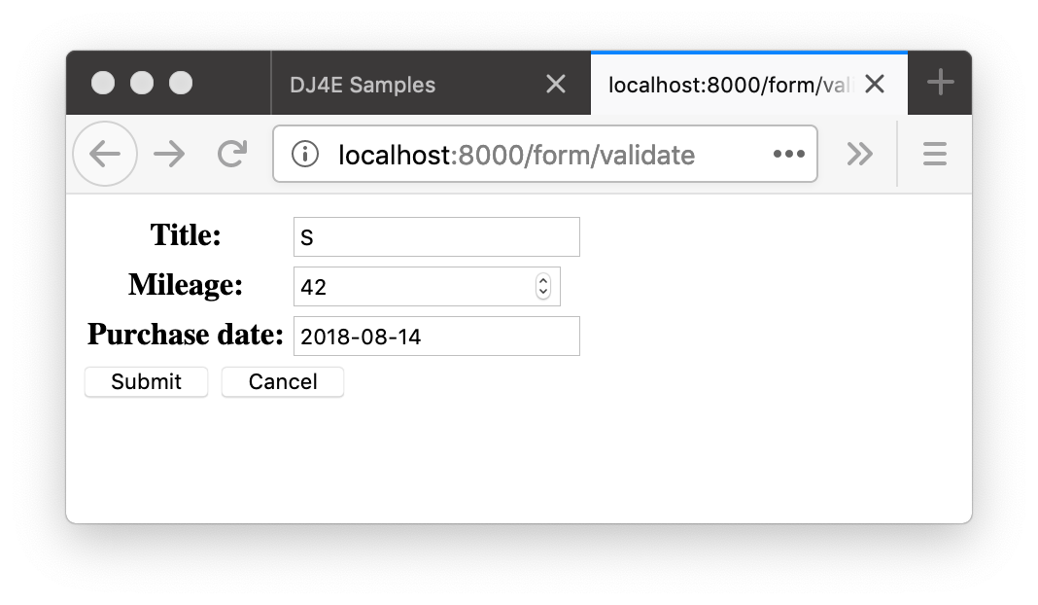
Validation
class Validate(DumpPostView):
def get(self, request) :
old_data = {
'title': 'SakaiCar',
'mileage' : 42,
'purchase_date': '2018-08-14'
}
form = BasicForm(initial=old_data)
ctx = {'form' : form}
return render(request, 'form/form.html', ctx)
def post(self, request) :
form = BasicForm(request.POST)
if not form.is_valid() :
ctx = {'form' : form}
return render(request, 'form/form.html', ctx)
# If there are no errors, we would save the data
return redirect('/form/success')
def success(request) :
return HttpResponse('Thank you!')
POST
200

Slide 23
Models + Forms
Crossing the streams
https://docs.djangoproject.com/en/3.0/topics/forms/modelforms/

Slide 24
Form Structure is similar to Model Structure
dj4e-samples/form/forms.py
class BasicForm(forms.Form):
title = forms.CharField(validators=[
validators.MinLengthValidator(2, "...")])
mileage = forms.IntegerField()
purchase_date = forms.DateField()
dj4e-samples/form/models.py
class Cat(models.Model) :
name = models.CharField(
max_length=100,
validators=[MinLengthValidator(2, "..")]
)
breed = models.CharField(max_length=100)
comments = models.CharField(max_length=100, blank=True)

Slide 25
We can derive a form from a model
dj4e-samples/form/models.py
class Cat(models.Model) :
name = models.CharField(
max_length=100,
validators=[MinLengthValidator(2, "..")]
)
breed = models.CharField(max_length=100)
comments = models.CharField(max_length=100, blank=True)
dj4e-samples/form/forms.py
class CatForm(ModelForm):
class Meta:
model = Cat
# fields = ['name', 'breed', 'comments']
fields = '__all__'

Slide 26
Model
dj4e-samples/form/views.py
class CatCreate(View):
def get(self, request) :
form = CatForm()
ctx = {'form' : form}
return render(request, 'form/form.html', ctx)
def post(self, request) :
form = CatForm(request.POST)
if not form.is_valid() :
ctx = {'form' : form}
return render(request, 'form/form.html', ctx)
# Save the form and get a model object
newcat = form.save()
x = reverse('form:main') + '#' + str(newcat.id)
return redirect(x)

Slide 27
Model
dj4e-samples/form/views.py
class CatUpdate(View):
def get(self, request, pk) :
oldcat = get_object_or_404(Cat, pk=pk)
form = CatForm(instance=oldcat)
ctx = { 'form': form }
return render(request, 'form/form.html', ctx)
def post(self, request, pk) :
oldcat = get_object_or_404(Cat, pk=pk)
form = CatForm(request.POST, instance=oldcat)
if not form.is_valid() :
ctx = {'form' : form}
return render(request, 'form/form.html', ctx)
editcat = form.save()
x = reverse('form:main')
return redirect(x)

Slide 28
Summary
Django forms
Form Validation
Models and Form

Slide 29
Acknowledgements / Contributions
These slides are Copyright 2019- Charles R. Severance (www.dr-chuck.com) as part of www.dj4e.com and made available under a Creative Commons Attribution 4.0 License. Please maintain this last slide in all copies of the document to comply with the attribution requirements of the license. If you make a change, feel free to add your name and organization to the list of contributors on this page as you republish the materials.
Initial Development: Charles Severance, University of Michigan School of Information
Insert new Contributors and Translators here including names and dates
Continue new Contributors and Translators here

Slide 30
Additional Source Information
Portions of the text of these slides is adapted from the text www.djangoproject.org web site. Those slides which use text from that site have a reference to the original text on that site. Django is licensed under the three-clause BSD license.

